Slide 1




SQL Challenge -Atliq Hardwares Domain: Consumer goods
Created by: Sai Ram Kalluru

Slide 2
About the Challenge
Conducted as part of a hiring process for Atliq Hardwares
Tasked with solving 10 business-critical ad hoc requests
Objective: Provide data-driven insights for executive decision-making
Delivered findings through SQL queries

Slide 3
About the Company
Atliq Hardware's is a leading computer hardware manufacturer in India, operating on a fiscal year from September to August. In recent years, the company has expanded its presence internationally. However, the management has identified gaps in data-driven decision-making and aims to strengthen its analytics team. To address this, they designed an SQL challenge to evaluate candidates on their technical and analytical skills.

Slide 4
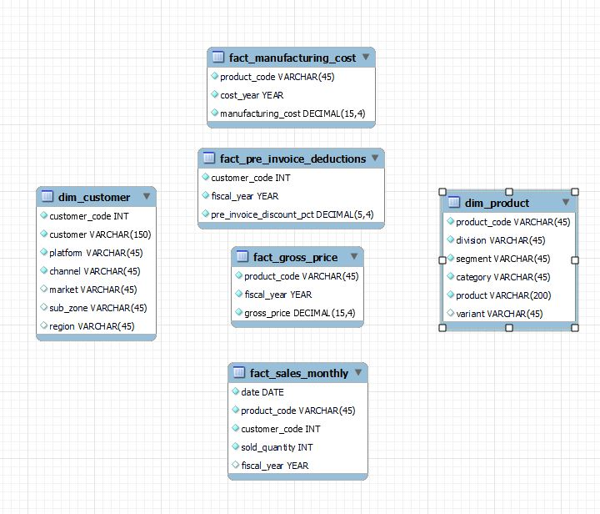
Getting familiar with the data provided
1. dim_customer: contains customer-related data
2. dim_product: contains product-related data
3. fact_gross_price: contains gross price information for each product
4. fact_manufacturing_cost: contains the cost incurred in the production of each product
5. fact_pre_invoice_deductions: contains pre-invoice deductions information for each product
6. fact_sales_monthly: contains monthly sales data for each product.

Slide 5
Order of SQL Query Execution:
FROM → Identifies the source tables.
JOIN → Combines tables based on the conditions.
WHERE → Filters rows before aggregation.
GROUP BY → Groups the data based on specified columns.
COUNT (*) (or other aggregate functions) → Applied after grouping.
HAVING → Filters aggregated data
SELECT → Retrieves the final columns and calculated values.
ORDER BY → Sorts the result set.
OFFSET → Skip a certain number of rows.
LIMIT → Restricts the number of rows returned (if used).

Slide 6
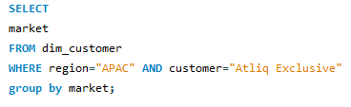
Request 1
Business Question: List the markets where "Atliq Exclusive" operates in APAC region
SQL Query Used:

Slide 7
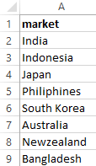
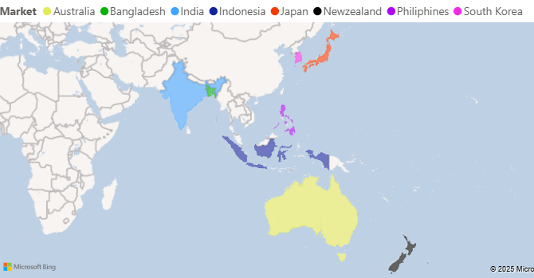
Output:
Insight: Atliq Exclusive operates in 8 APAC markets.

Slide 8
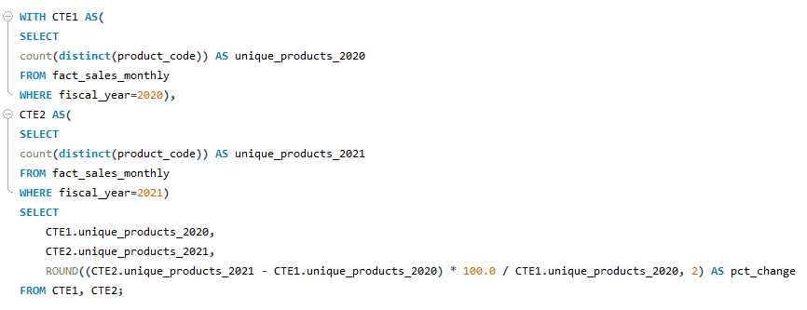
Request 2
Business Question: What is the percentage change in unique products from 2020 to 2021?
SQL Query Used:

Slide 9
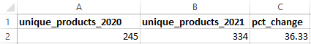
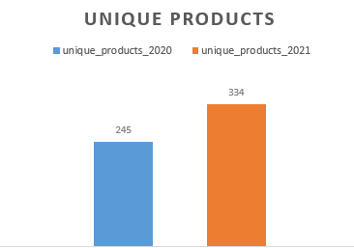
Output:
Insight: Unique products increased by 36.33% in 2021.

Slide 10
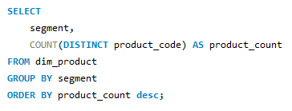
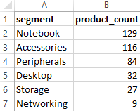
Request 3
Business Question: Report unique product counts per segment, sorted in descending order.
SQL Query Used:
Output:

Slide 11
Insight: Notebooks segment had the highest unique products.

Slide 12
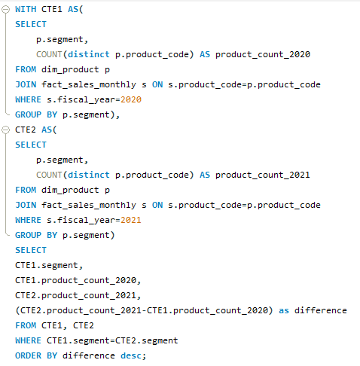
Request 4
Business Question: Which segment had the most increase in unique products from 2020 to 2021?
SQL Query Used:

Slide 13
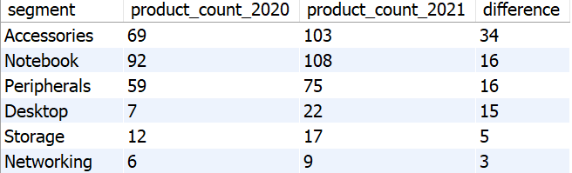
Output:
Insight: With a difference of 34, Accessories segment had the highest increase in unique products.

Slide 14
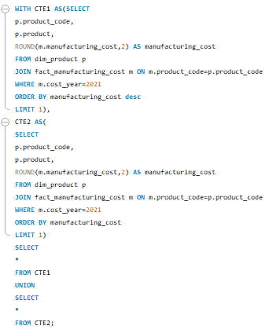
Request 5
Business Question: Identify products with the highest and lowest manufacturing costs.
SQL Query Used:

Slide 15
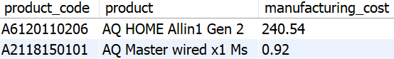
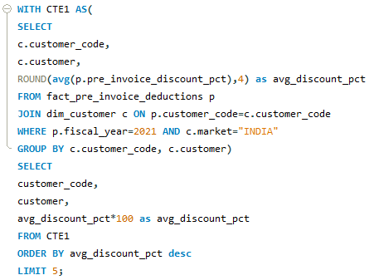
Request 6
Output:
Insight: AQ HOME Allin1 Gen 2 had the highest, and AQ Master wired x1 Ms had the lowest manufacturing cost.
Business Question: Find the top 5 customers in India who received the highest average pre-invoice discount percentage in 2021?
SQL Query Used:

Slide 16
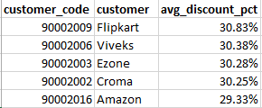
Output:
Insight: At 30.83%, Flipkart had the highest average pre-invoice discount percentage among Indian customers, followed by Viveks, Ezone, Croma, and Amazon.

Slide 17
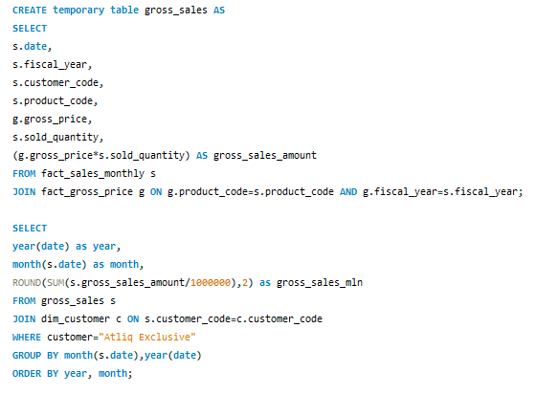
Request 7
Business Question: Monthly gross sales of "Atliq Exclusive".
SQL Query Used:

Slide 18
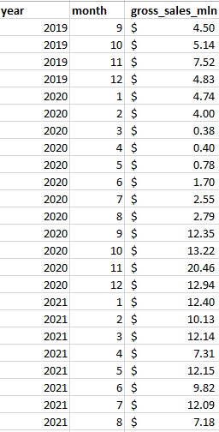
Output:

Slide 19
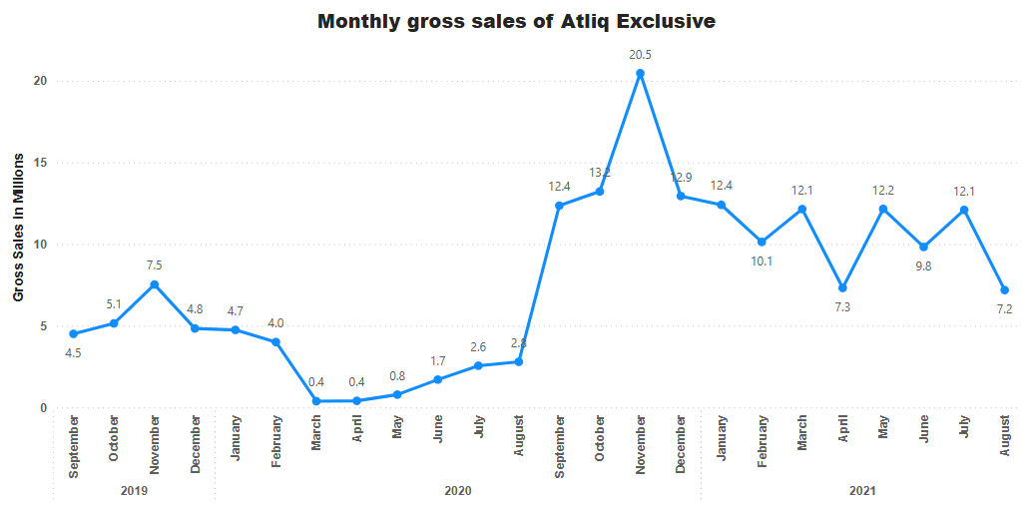
Insight: With 20.5 million gross sales, November 2020 was the month with highest gross sales.
FY 2020
FY 2021

Slide 20
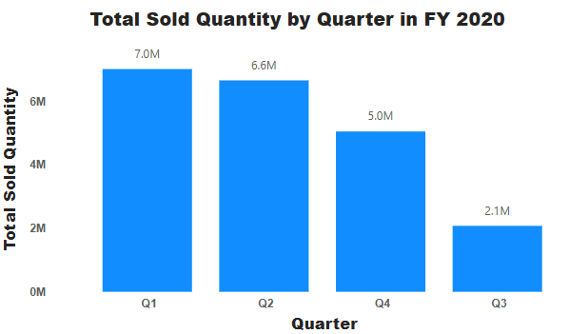
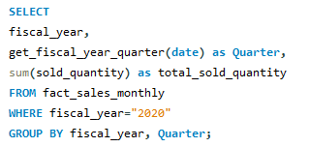
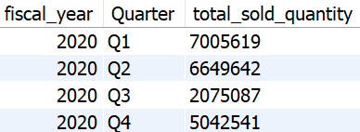
Request 8
Business Question: Which quarter in FY 2020 had the highest total sold quantity?
SQL Query Used:
Output:
Insight: Q1 2020 had the highest sales with 7M+ units sold.

Slide 21
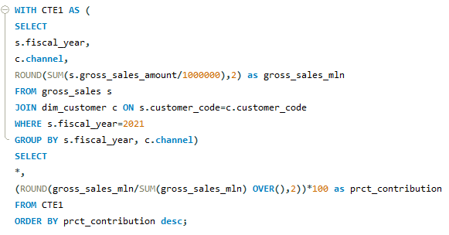
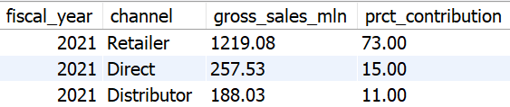
Request 9
Business Question: Which channel contributed the most to gross sales in 2021 and its percentage?
SQL Query Used:
Output:

Slide 22
Insight: Retailer Channel contributed $1,219.08M, the highest in 2021.

Slide 23
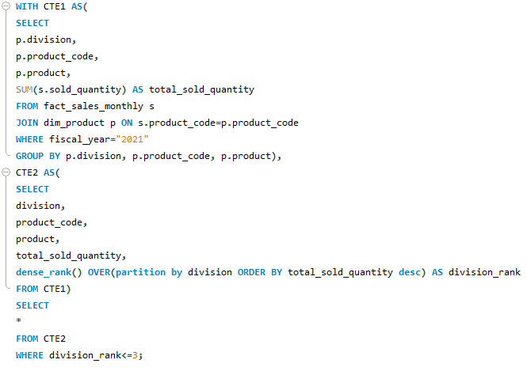
Request 10
Business Question: Top 3 best-selling products in each division in 2021 ?
SQL Query Used:

Slide 24
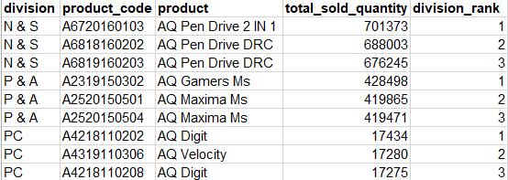
Output:
Insight: Identified top 3 products per division to improve inventory planning.

Slide 25
Conclusion
Through this challenge, I applied advanced SQL techniques to extract key business insights. The findings highlight opportunity for market expansion, product growth, cost optimization and sales strategy.

Slide 26
Thank You For Watching!

